Slide 1
Joint Strategic Needs Assessment
2014
Health and Wellbeing Board
24th June 2014
Houda Al-Sharifi
Director of Public Health
Laurence Gibson
Head of Knowledge Management
Wandsworth Borough Council
Notes:
Speak to Laurence about who the audience is (HWB?), time allocated to presentation and deadline?

Slide 2
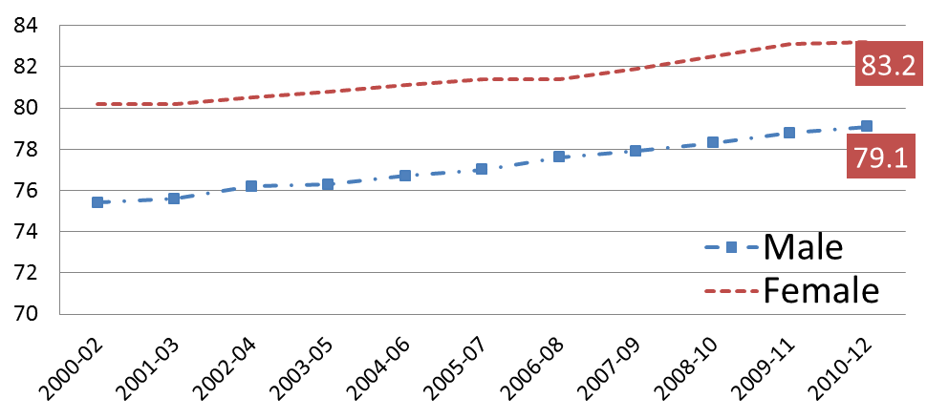
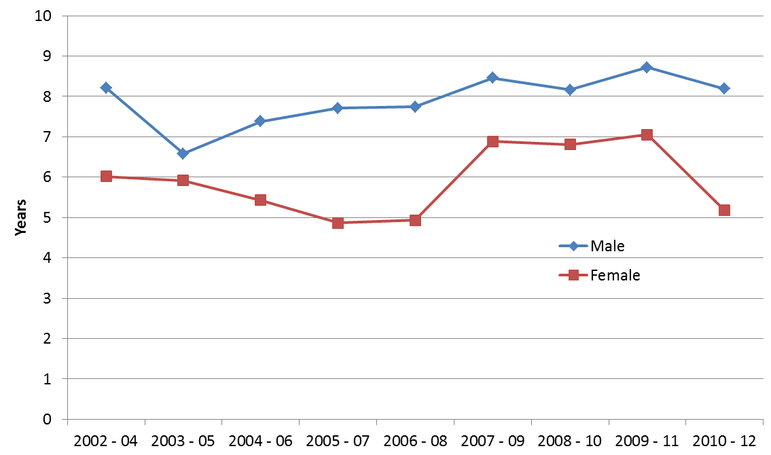
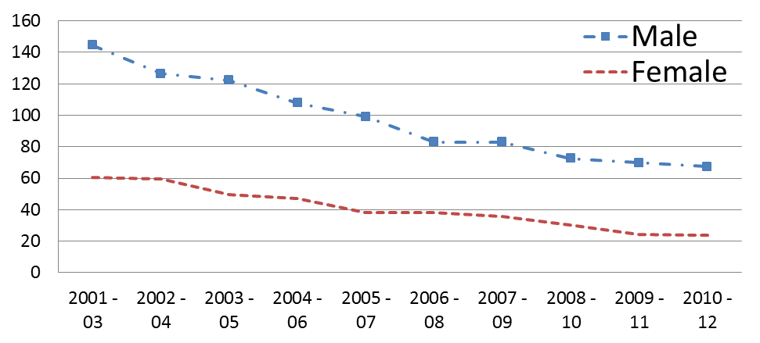
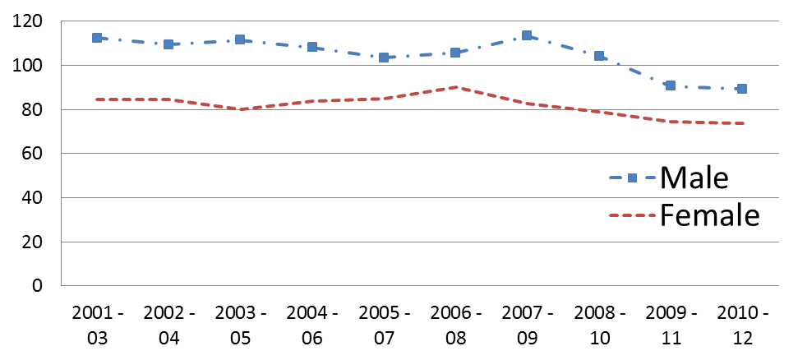
Wandsworth Health Overview
Life Expectancy | Slope index of inequality in life expectancy Source: PHOF local deprivation deciles
Premature mortality <75 mortality rate from cardiovascular diseases considered preventable <75 mortality rate from cancer considered preventable Age standardised rate per 100,000 Source: ONS
In 2010/12 there was a difference of 8 years in the life expectancy of a man, and 5 years of a woman between the most affluent and the most deprived populations.

Slide 3
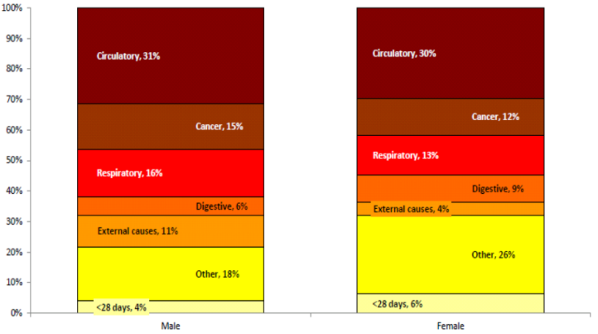
Life expectancy gap between the most and least deprived
Circulatory disease is the largest contributor to the life expectancy gap
The life expectancy gap between the affluent and the deprived is 8.2 years for males and 5.2 years for females
Source: Segment Tool PHE 2014

Slide 4
Number and rate of deaths in Wandsworth for 2012
 | Number of deaths |  | Standardised Rate per 100,000
 | All ages | Under 75 | All ages | Under 75
Circulatory disease | 452 | 123 | 151.6 | 58.9
Coronary heart disease | 208 | 67 | 72.0 | 32.7
Cancer | 449 | 223 | 170.5 | 147.2
Total deaths | 1547 | 552 | 529.5 | 250.1
Source: ONS

Slide 5

Reds for Wandsworth against England
Child Poverty
Central Heating
Overcrowding
Pensioners living alone
Older people in deprivation
Emergency CHD
Emergency COPD
Cancer incidence
Prostate cancer incidence
Circulatory mortality under 75

Slide 6
Selected indicators against Inner London
Wandsworth
Inner London
14.5 | 21.1
28.3 | 39.4
97.1 20.1 38.6 26.4 33.3 | 96.7 28.7 41.6 31.8 43.1
84.9 | 93.6
2787.0 | 2785.0
99.0 | 87.5
121.0 | 139.4
105.2 | 98.6
99.8 | 93.5
97.1 | 89.0
122.1 | 116.7
113.4 | 99.9
102.4 | 108.1
102.5 | 100.6
113.2 | 116.4
85.7 | 106.2
98.8 | 93.7
98.5 | 97.1
101.9 | 92.6
87.8 | 90.8
25.3 | 14.7
Income Deprivation (%)
Child Poverty (%)
Households with central heating (%) Overcrowding (%) Pensioners living alone (%) Older People in Deprivation (%) Hospital stays for self harm (SAR*)
Hospital stays for alcohol related harm (SAR*)
Chlamydia Diagnoses (15-24) per 100,000⁺
Emergency admissions for hip fracture in 65+ (SAR*)
Emergency admissions for Chronic Obstructive Pulmonary Disease (SAR)
Incidence of all cancer (SRR)
Incidence of breast cancer (SRR)
Incidence of colorectal cancer (SRR)
Incidence of lung cancer (SRR)
Incidence of prostate cancer (SRR)
Deaths from all causes, under 75 years (SMR**)
Deaths from all cancer, under 75 years (SMR**)
Deaths from circulatory disease, under 75 years (SMR**)
Deaths from coronary heart disease, under 75 years (SMR**)
Deaths from all causes, all ages (SMR)
Deaths from all cancer, all ages (SMR)
Deaths from circulatory disease, all ages (SMR)
Deaths from coronary heart disease, all ages (SMR)
Excess Winter Deaths Index
*Standardised Admission Ratio, ** Standardised Mortality Ratio ⁺The Inner London rate is skewed due to the extremely high rate in Lambeth of 6131

Slide 7
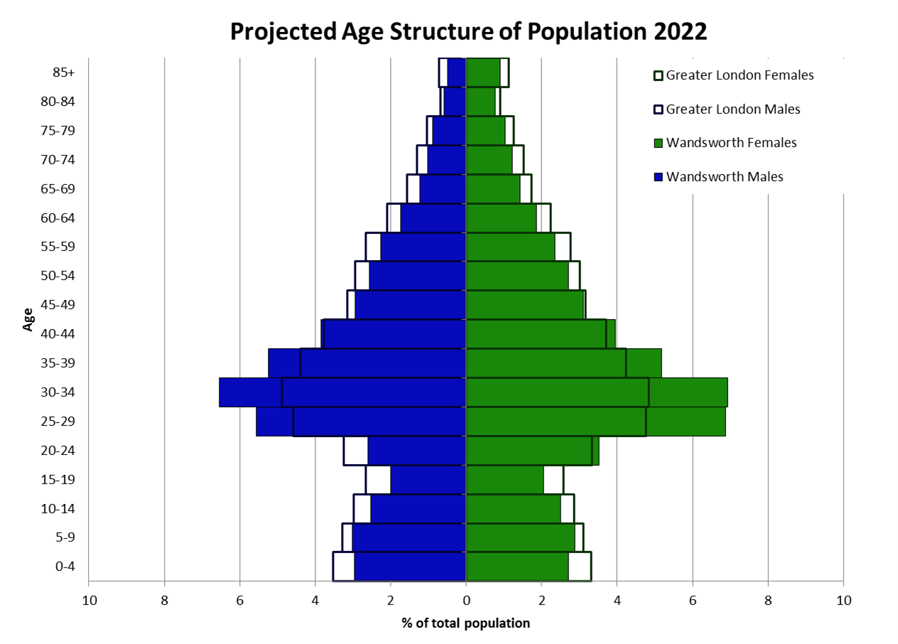
Latest data: Population pyramid by five year age bands and gender
Source: ONS sub-national 2011-based population projections

Slide 8
General Fertility Rate,
Wandsworth 2000-2012
The general fertility rate (GFR) is the number of live births per 1,000 women aged 15-44
Source: ONS 2013

Slide 9
Population Projections
Source: GLA 2013, round demographic projections
Age group

Slide 10
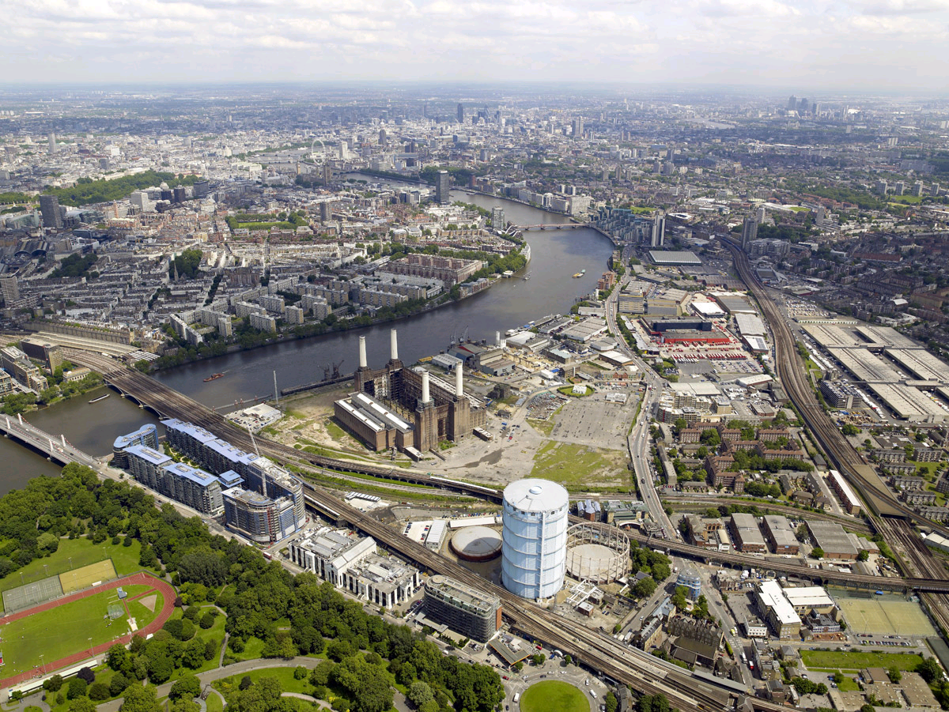
Nine Elms and Vauxhall
For Wandsworth: potential 14,000 new homes and 20,000 jobs
Expect:
Maternity services, 4500 women aged 16-40 by 2018, with 250 babies a year
Smoking and emergency admission for Chronic Obstructive Pulmonary Disease. (COPD admissions ratio of 183)*
HIV prevalence in 2011 is between 10 and 20 per 1000 population, double the London rate
*APHO GP profile for Riverside

Slide 11
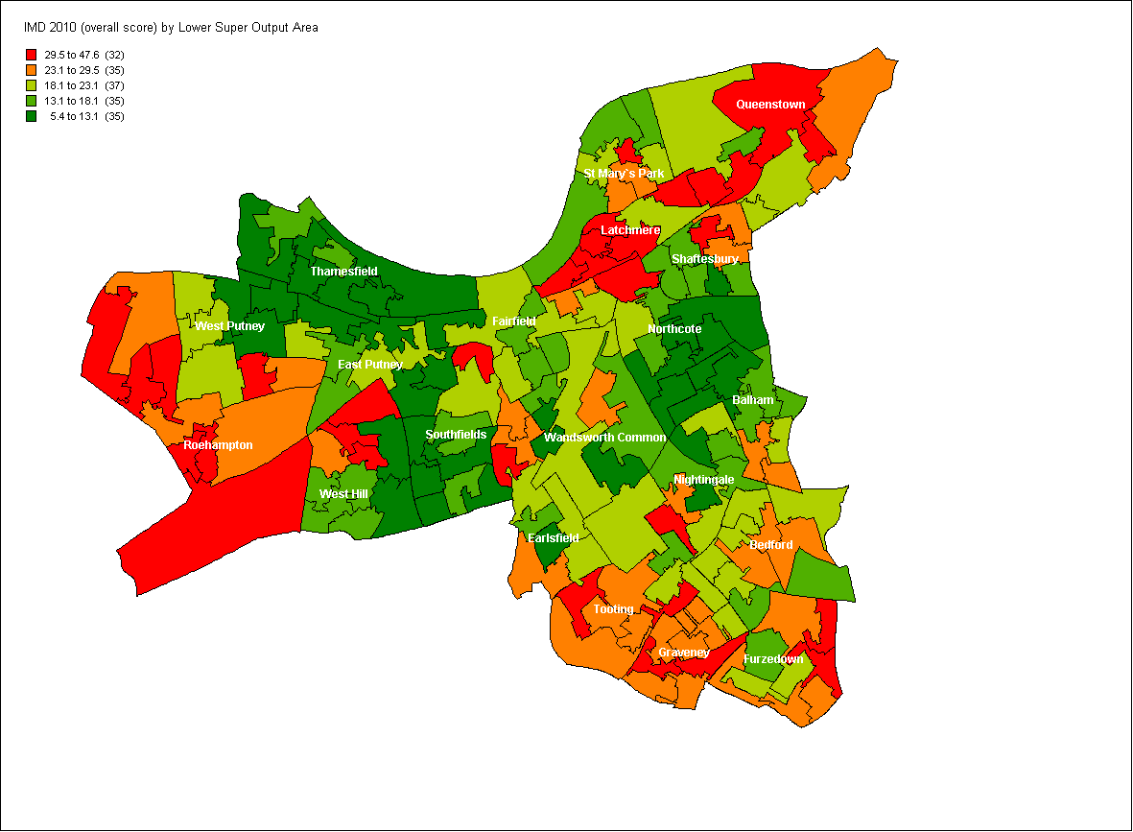
Deprivation map for Wandsworth
Deprivation encompasses a range of domains: financial, health, education, services or crime.
Areas of high socioeconomic deprivation are characterized by high levels of social housing, lone parents with dependent children, benefit claiming households and low levels of educational attainment.
Latchmere, Roehampton and Queenstown are the most deprived wards while Southfields, Northcote and Thamesfield are the least deprived wards.
Notes:
Latchmere, Roehampton and Queenstown are the 3 most deprived wards in the borough while Southfields, Northcote and Thamesfield are the least deprived wards.
From 2007 to 2010, the IMD increased from 197,000 people lived in areas where deprivation got better, while 86,000 people lived in areas where deprivation increased.

Slide 12
Wider determinants of health
The APHO health profiles give a number of indicators to profile health in local areas. As part of these indicators the relative position of the wider determinants of health in Wandsworth to the England is presented below:
A comparison with Inner London is not available from the same source, however deprivation in Inner London is higher than England, and in Wandsworth an example is the 11,785 children living in poverty
Source: APHO Health Profiles / Index of Multiple Deprivation 2010

Slide 13
Wider determinants of health
Deprivation
Housing availability and pressures on Private Rental Sector currently 32% of all households
Monitoring the impact of welfare reform,
  Local Housing Allowance
  Council Tax Reduction
  Weekly benefit cap
Educational attainment, KS2 82% against 76% nationally, with a range between 94%-79%
Crime, including domestic violence and 21% increase with 508 cases
Unemployment, 4,879 (2.1%) at March 2014 and association with BME groups

Slide 14
Employment rate London 2013
Aged 16-64

Slide 15
Unemployment (JSA) by ethnicity and age
Source: Office for National Statistics © Crown Copyright and database right 2012

Slide 16
Update against 2011 JSNA Indicators
Teenage conceptions
Excess winter deaths
Falls and fractured neck of femurs
Sexually Transmitted Infections
Under 75 mortality for cancer
Under 75 mortality for cardiovascular disease
High childhood obesity levels
Alcohol related hospital admissions
Immunity for measles, mumps, and rubella
Carers receiving needs assessment
Independence for older people through rehabilitation and intermediate care
Improving trend
Stable trend
Worsening trend

Slide 17
Summary of messages
Smoking prevalence
Cervical screening
Breastfeeding at 6 weeks
Children in deprived households
Mental Health and Self reported wellbeing
Alcohol related admissions
Breast and bowel screening
Children excess weight
Adult obesity and lack of physical activity
Chlamydia diagnoses
Deprived households
High burden (>2,000)
Teenage pregnancy
Unemployment
Low birth weight babies
First time entrants to youth justice system
Mortality from preventable causes
Suicide
Domestic violence
Drug treatment completion
TB treatment completion
Preventable sight loss (glaucoma)
Excess Winter Deaths
Injuries due to falls particularly female
Residents with Learning Disabilities
Looked after children
Tuberculosis treatment
Care Home residents
Offender health
Sexual exploitation of children
Female Genital Mutilation
Low burden (<2,000)
Improving
Worsening / unknown

Slide 18
End

Slide 20
Summary of messages high burden and worsening trend
Estimated 48,500 16-64 year olds with a mental health disorder with known impact on other conditions or areas of life particularly for black ethnic groups
Mental Health and wellbeing
Alcohol related admissions
Breast and bowel screening
Deprived households
Children excess weight
Adult obesity and lack of physical activity
Chlamydia diagnoses
Estimated 50,800 binge drinking adults in Wandsworth. Alcohol related hospital admissions have risen from 3,249 in 2007/8 to 4,755 in 2011/12
Breast cancer screening coverage in females aged 53-70 dropped from 65% in 2010 to 61% in 2013. Bowel screening is unknown
41,634 people living in means tested benefit households. IMD increase, 20.4 to 21.5 from 2007 to 2010
In 2012/13, 558 4/5 year olds and 684 10/11 year olds were identified as overweight or obese
52% of adults in 2012 were overweight, (133,000 people). 23% were doing less than 30 minutes of moderate intensity physical activity (84,000 people)
977 cases of Chlamydia in residents aged 15-24 years. Additionally a recent increase in people over 50.

Slide 21

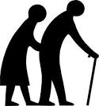

Conclusion: Summary of Public Health Key Priorities
Infants/ Children
Elderly
Adults
  Areas under target: immunisations (MMR) uptake: 83% (target 2012/13: 95%); breastfeeding: 73% (target: 76%)
High excess winter deaths in 2009/12- 363 in all ages; high injuries due to falls in 2011/12: 281 in those aged 65-79 years old and preventable eye disease (glaucoma)- 25 in those aged 40+ in 2011/12
  Sexually transmitted infections high (5,655 diagnosed in 2012); alcohol related hospital admissions increased (4755 admitted in 2011/12)
  Domestic violence: 21% annual increase in reported offences
  Care of vulnerable families (multi-agency approach)
  Mental Health: 48,500 people affected
  Lack of physical activity (23%) and significant proportion overweight (50%)
  Intensive needs: learning disabilities (23% known to services); 210 looked after children; tuberculosis patients (79% completed treatment; target 85%); 800 care home residents; offender health (1,000 people)
  Areas of inequality:
    Deprived communities: cancer mortality rate 29% higher in areas of highest socioeconomic deprivation; poor education- 7.1%16-18 year olds are not in education; smoking rates high in certain areas
    Long term unemployment: 9,311 in 2011
    Air quality monitoring in congested areas and access to open spaces.
Notes:
- Public health is about, protecting and improving health, preventing disease, and improving services to ensure that they are accessible and of high quality. Public health strives to overcome inequalities which are “…. a matter of life and death, of health and sickness, of well being and misery’ (Marmot review). The key to improving health is to prevent ill health before it starts or when it is at an early stage, from cradle to grave.
- I will now highlight some of the key public health priorities among different age groups:
Infants/children: It is important to give babies a good start in life ensuring babies are breastfed and immunised. Wandsworth is currently under target by 12% for MMR immunisations and 3% for breastfeeding.
2. Adults and the elderly: Sexually Transmitted Infections are particularly high (5,655 diagnosed in 2012); alcohol related hospital admissions have increased year on year (4,755 admitted in 2011/12).
3. Elderly: relatively poor rates of excess winter deaths (at a ratio of 25.3 for 2009-2012, the highest in London) and falls injuries (6th highest in London with 727 injuries in 2011/12), and a significantly high rate of preventable eye disease (3rd highest rate of preventable glaucoma in London).
4. Certain elements of public health affect all age groups such as:
a. domestic violence- there has been a 21% annual increase in reported offences
b. care of vulnerable families
c. mental health (approx. 48,500 people affected),
d. there is a lack of physical activity and
e. a significant proportion of people who are overweight.
There are a number of areas of intensive need:
it is estimated that on 23% of people with learning disabilities are known to services;
there are 210 vulnerable looked after children in the borough with poor life chances;
although new cases of tuberculosis have remained stable- 79% completed treatment in 2012 which is below the 85% target.
Appropriate and equitable access to the 800 care home residents needs to be ensured
There are 1,00 people on probations caseload. There are direct health impacts for offender and indirect impacts on family and friends.
There are also a number of smaller cohorts of patients who are disproportionately affected by (geographical) inequalities. Examples include- people who reside in deprived communities have a 29% higher cancer mortality rate than other areas, there is also a low educational attainment in more deprived communities. High smoking rates (> 283 per 1,000 population) are still observed in certain areas of the borough.
Wandsworth also has a high number of people who are in long term unemployment
On-going monitoring of air quality in congested areas is required as is promotion of using open spaces, particularly where access is limited.

